Slide 1
EE 74099 / EN 74099 Research Project
Progress Presentation For The Final Year Project
24.10.2019
Project title: Order Management System And Vision Based Autonomous Delivery Robot For Restaurants
Members:
ANFM. Begum, GSU. Ahmadh & IIS. Prema Sri
Supervised by : Dr. WGCW Kumara & Eng. MFM. Abdul Cader
Department of Electrical and Telecommunications Engineering
Faculty of Engineering
South Eastern University of Sri Lanka

Slide 2
Content
Introduction
Objective
Methodology
Order Management System
Robot Design and Control
Image Processing and Path Planning
External Vision Based Navigation and Path Planning
Appendix

Slide 3
Introduction
Our project is mainly on having an external vision based navigation system for indoor robots.
As for the application of it, a restaurant delivery robot will be built and run on this system.

Slide 4
Objective
Having a navigation system for internal robots by directing it with an external vision based navigation system and applying the system for restaurant delivery robot

Slide 5
Methodology
In order to achieve this, we are going to deal with our project into three parts as below,
Customer order management system
External vision based path planning
Robot’s hardware and control system

Slide 6
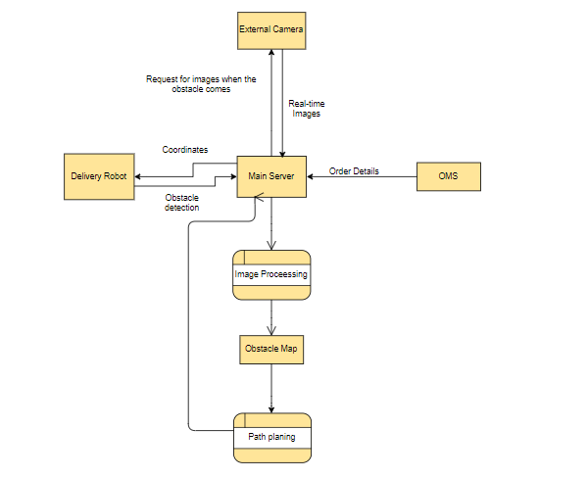
Data Flow Diagram for system

Slide 7
ORDER MANAGEMENT SYSTEM

Slide 8
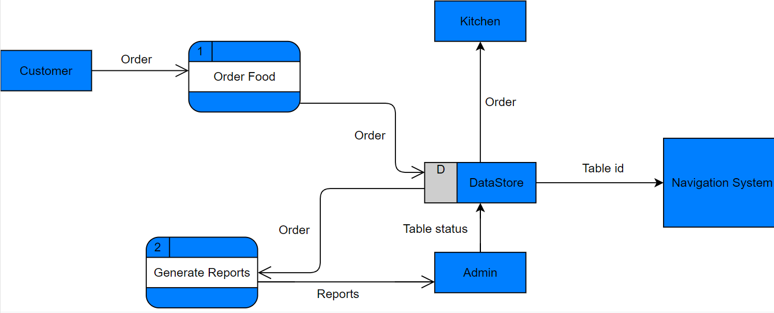
Data Flow Diagram for OMS

Slide 9
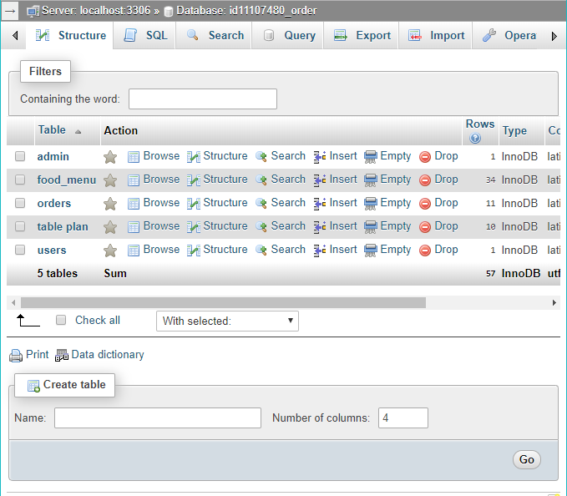
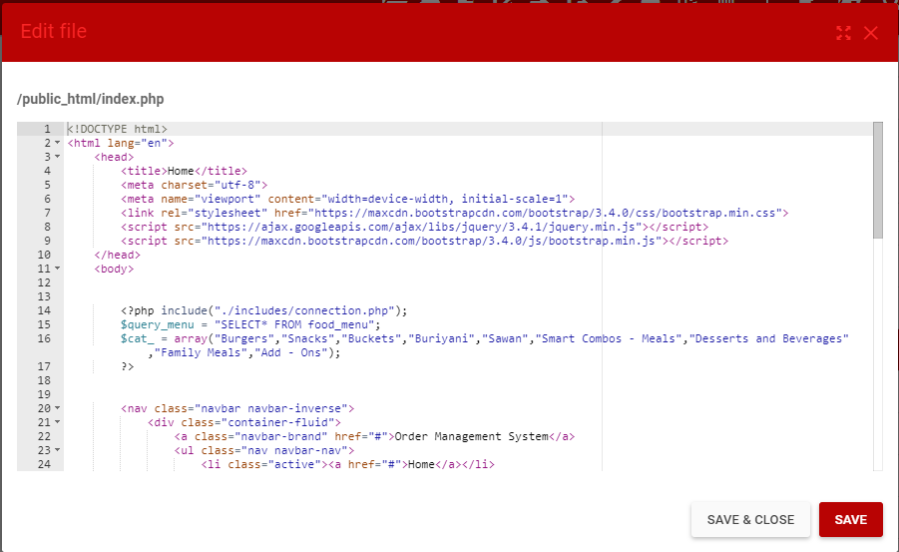
Development of the OMS Website
The required webpages were created and the website is now running in the domain fypoms.000webhostapp.com
We have used php, HTML,CSS and JavaScript languages and MariaDB database server for the OMS creation.

Slide 10
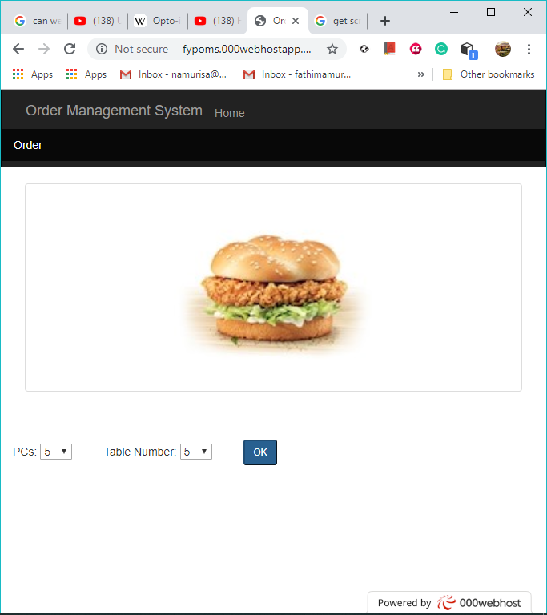
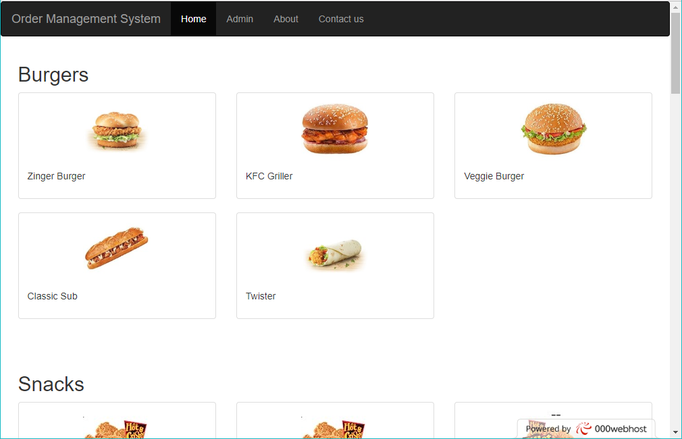
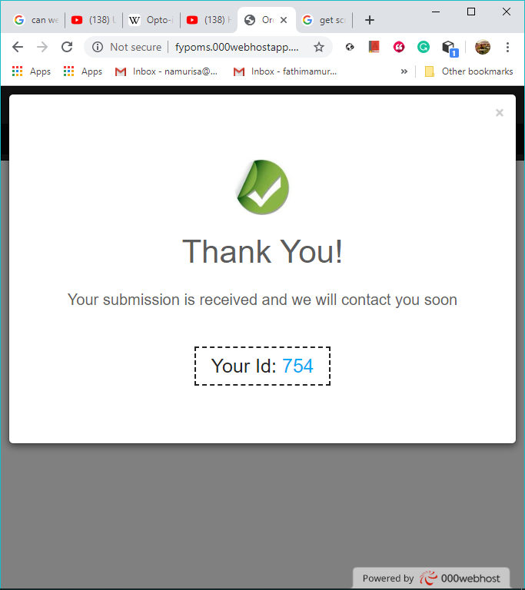
User Interface

Slide 11
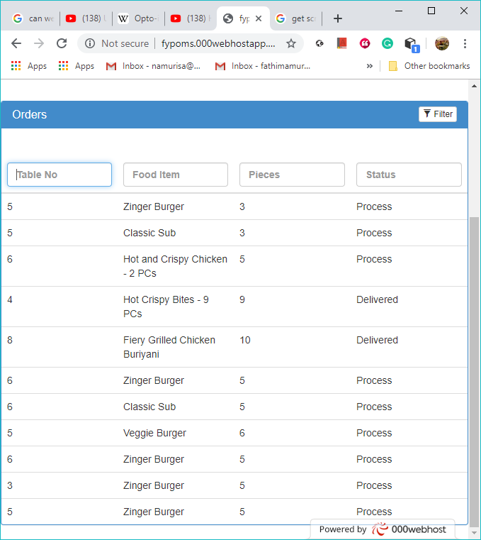
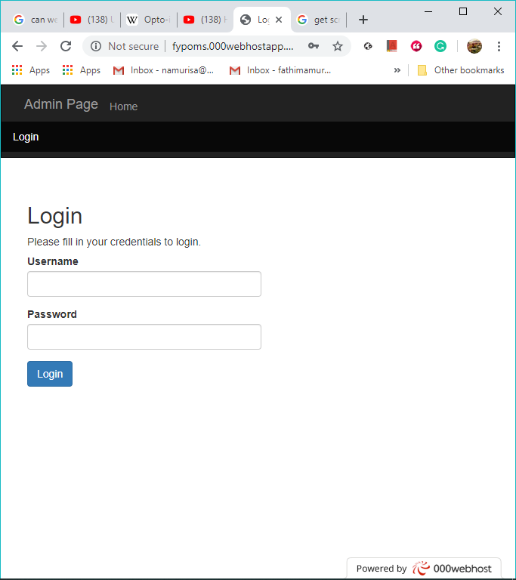
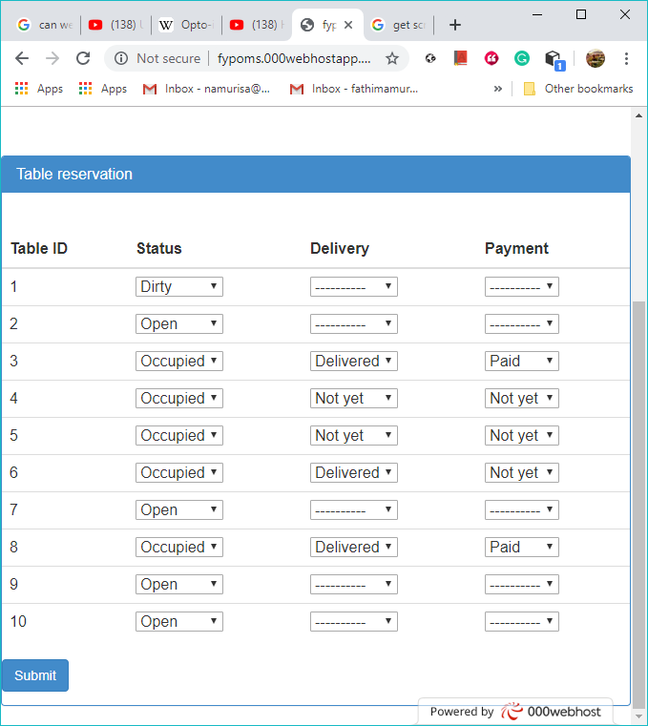
Admin Interface

Slide 12
ROBOT DESIGN AND CONTROL

Slide 13
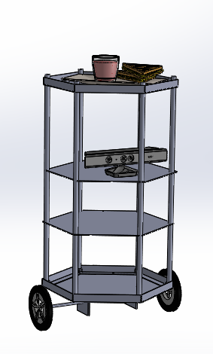
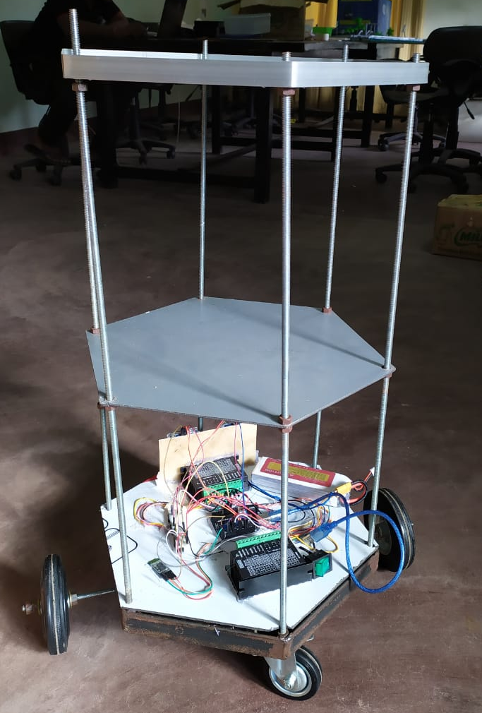
Designing Robot Model
We did a 3D model for the Robot design we are planning to build.
For the plates we decided to go with Aluminum Composite Material boards because of their strength and light weight.
To connect plates we used threaded rods.

Slide 14
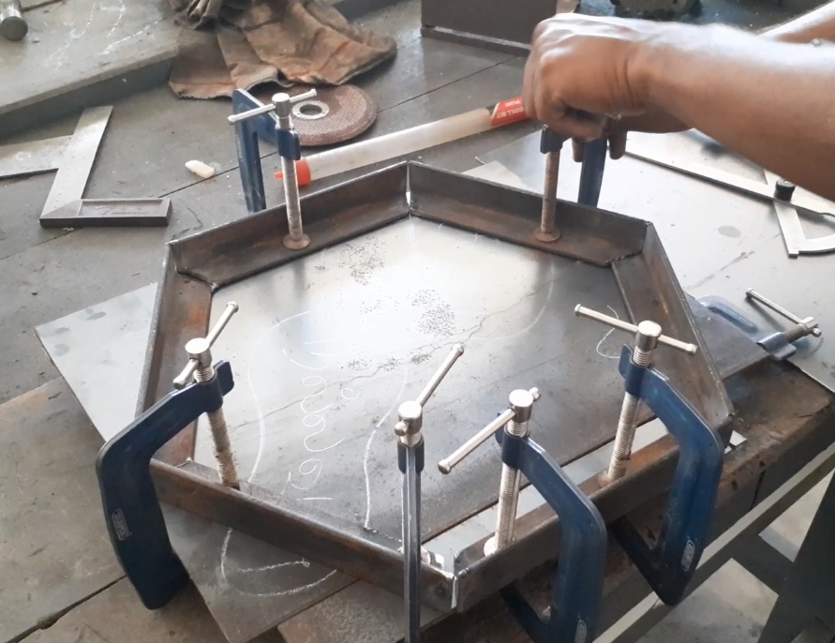
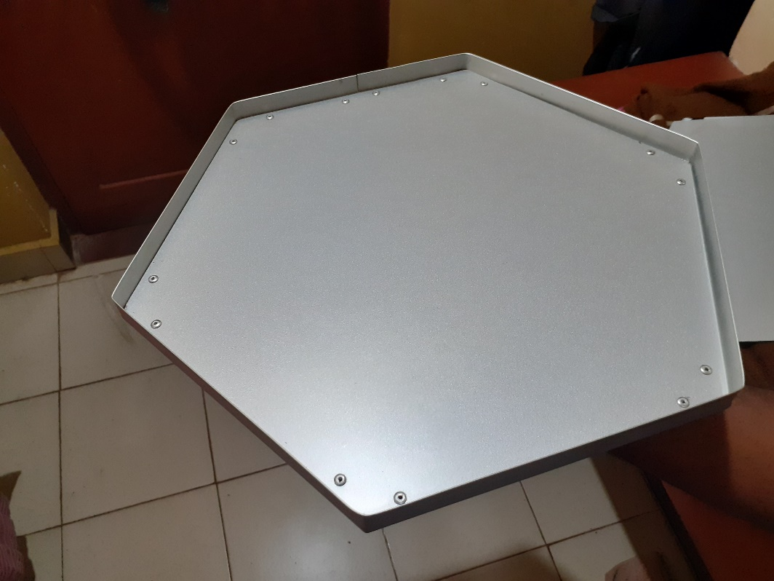
Selection of Material and Components
Bottom plate and L profile – Steel
Bottom plate should have strength to connect
motors and wheels.
Middle and top plates – ACM (Aluminum Composite Material )
The material selected should have strength and
also it should be light weight.

Slide 15
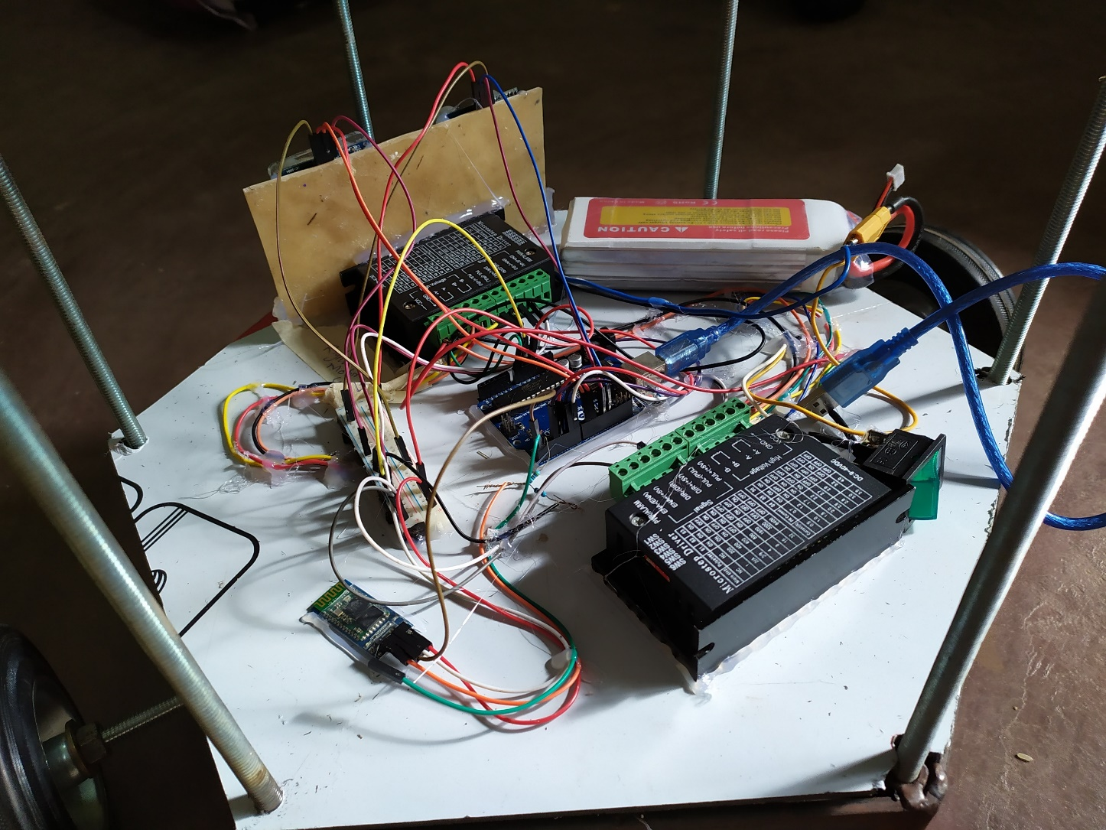
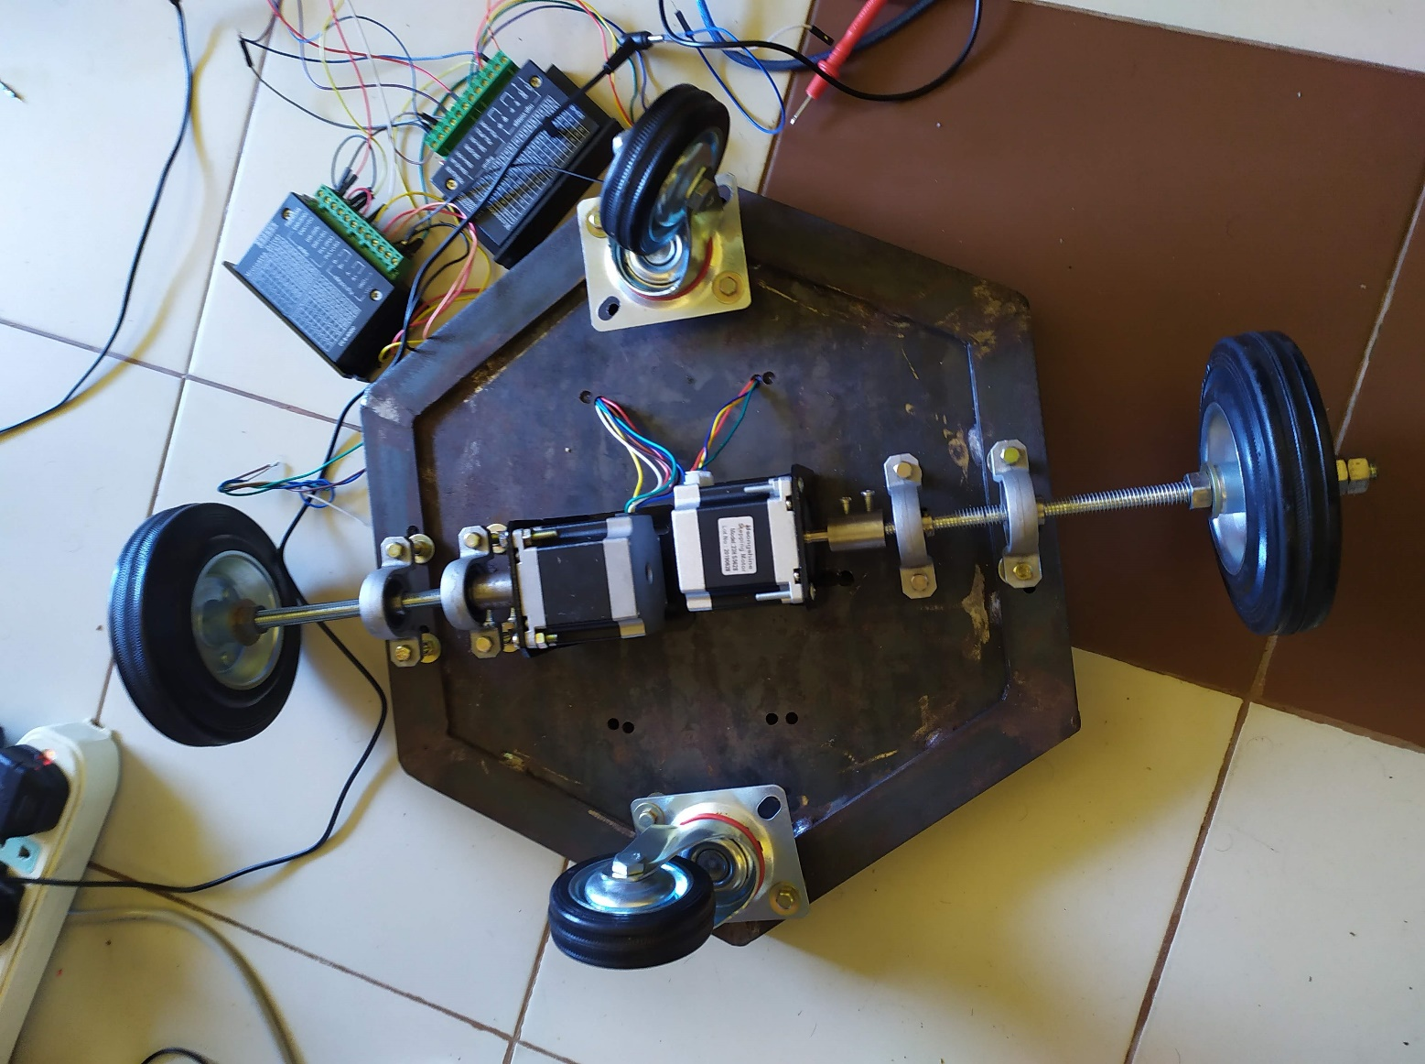
Selection of Material and Components
NEMA 23 Stepper Motor
TB6600 Stepper Motor Driver
Arduino Uno Microcontroller board
Nvidia Jetson Nano single board computer

Slide 16
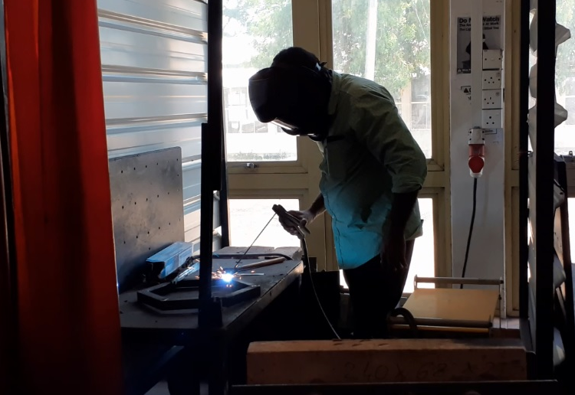
Building the Robot

Slide 17

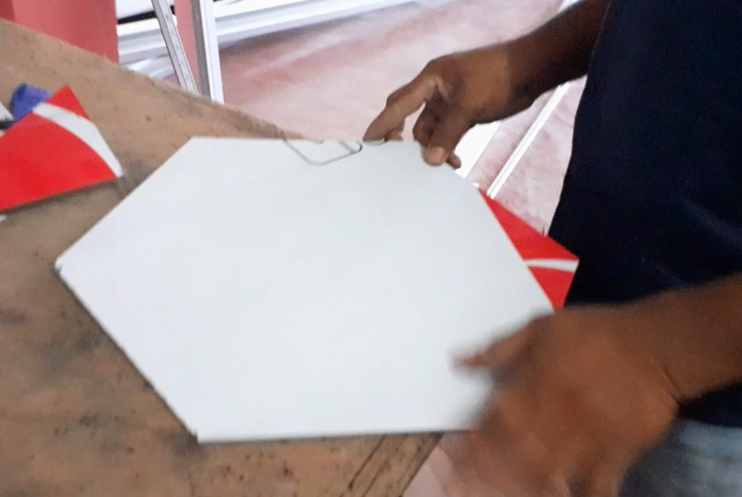
Building the Robot

Slide 18
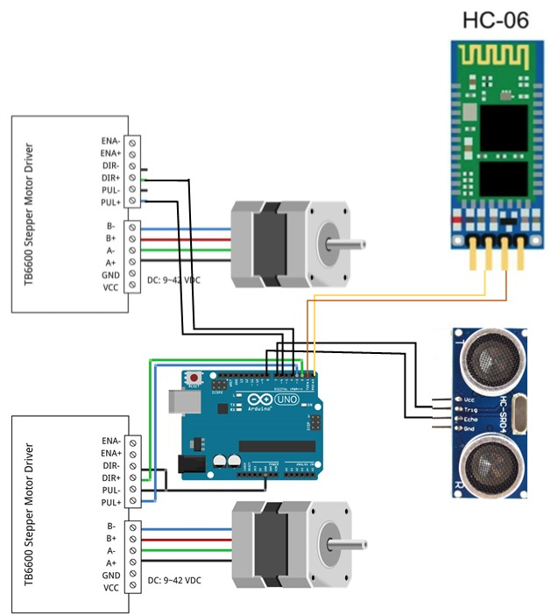

Building the Robot

Slide 19
IMAGE PROCESSING AND PATH PLANNING

Slide 20
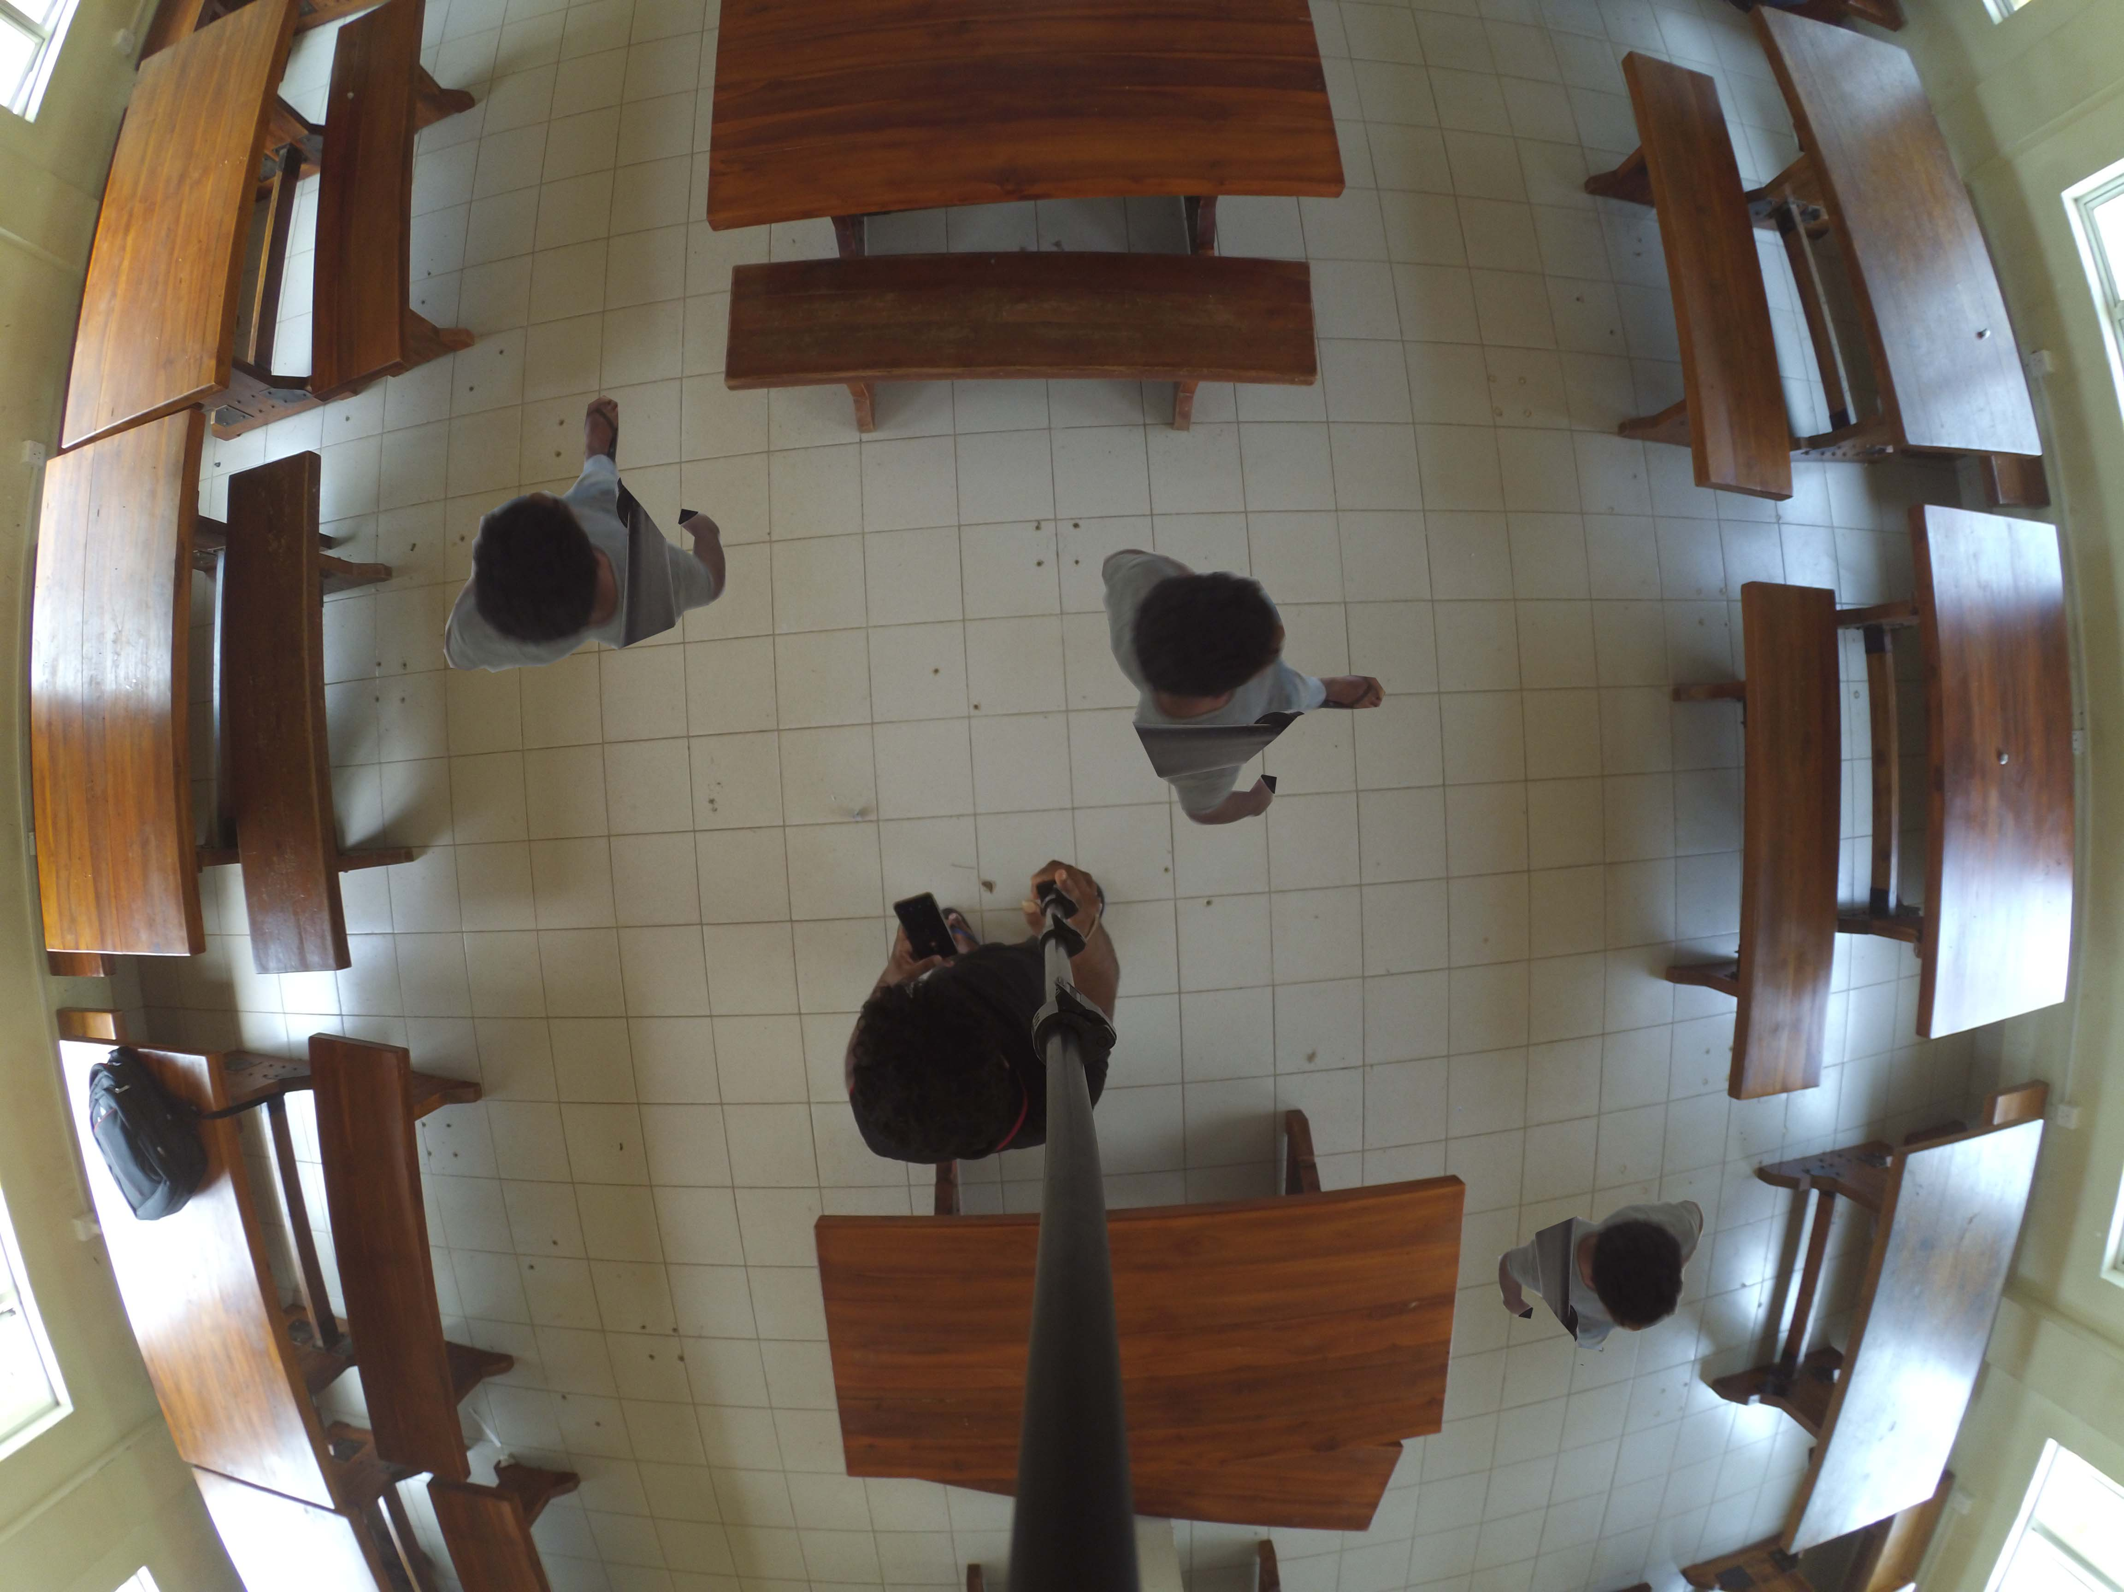
Camera Calibration
The camera we use should have a wide viewing angle to cover the area.
The images from wide angle cameras has lens distortion. We used camera calibration to remove the effects of lens distortion.
We used MATLAB Camera calibrator from Computer Vision Toolbox.
Before Camera Calibration

Slide 21
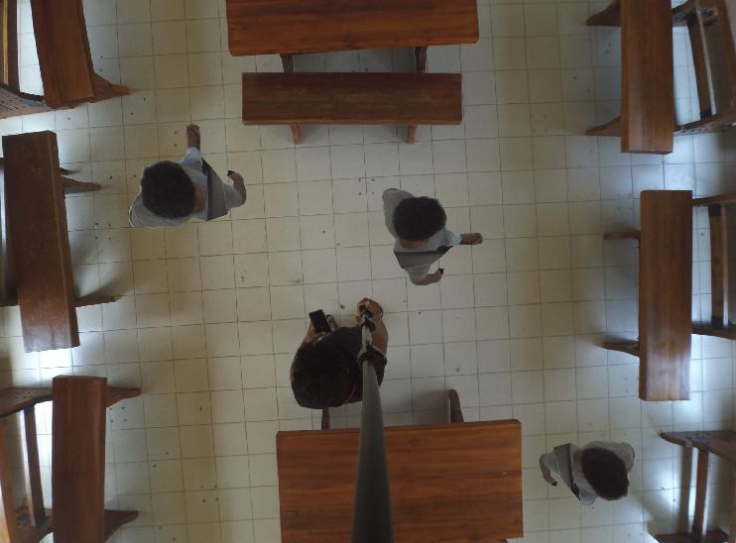
Camera Calibration
Calibration process estimates camera intrinsic, extrinsic, and lens distortion parameters.
Those parameters are used to remove the effects of lens distortion from an image.
After Camera Calibration

Slide 22
Image Processing
We need to pre process image before use it with path planning algorithm. We used MATLAB Computer Vision Toolbox for Image processing.
Image resizing
We used Image resizing to decrease the total number of pixels in the image to reduce the processing power needed and processing time.
Resolution - 3400x4600
Resolution - 360x480

Slide 23
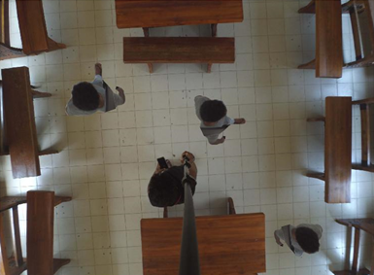
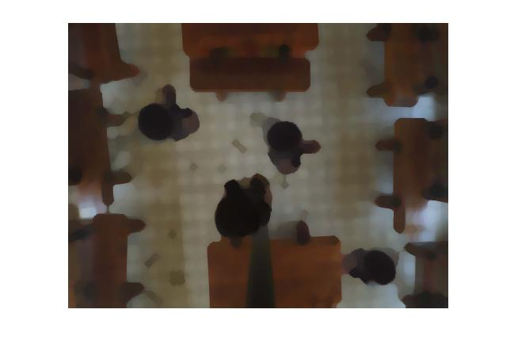
Image Processing
Image Erosion and dilation
Erosion removes pixels on object boundaries while Dilation adds pixels to the boundaries of objects in an image.
Resized Image
With Image Erosion
With Image Dilation

Slide 24
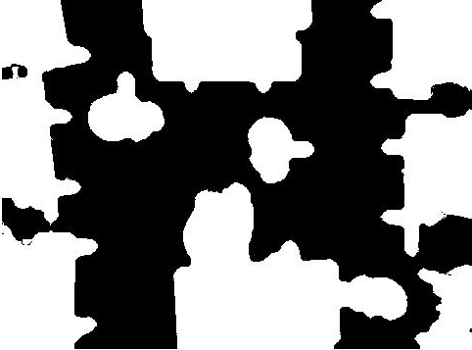
Image Processing
Image segmentation
We use Image segmentation to partition the image into multiple segments.
With Image Dilation
After Image Segmentation
Notes:
The goal of segmentation is to simplify the representation of an image into something that is more easier to analyze.

Slide 25
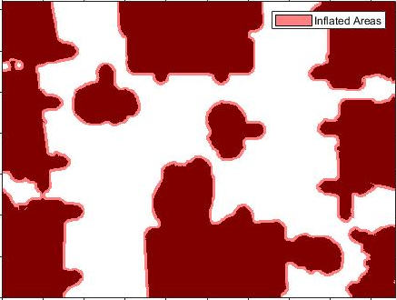
Path Planning
Creating Costmap
Here we creates a 2D Costmap to representing planning space for the path planning algorithm.
After Image Segmentation
Costmap

Slide 26
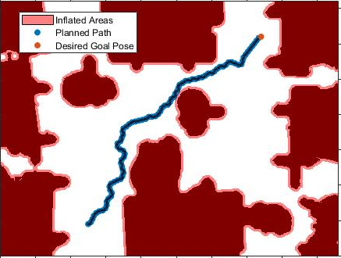
Path Planning
Path Planning with RRT algorithm
Creates a path from start point to end point in Costmap using Optimal Rapidly Exploring Random Tree (RRT*) algorithm.
RRT provides a quick solution to generate paths with having no necessity of defining grids and nodes unlike in other shortest path algorithms like Dijkstra.
Planned path in costmap

Slide 27
Path Planning
Path Planning with RRT algorithm
RRT planner explores the environment from the starting point by constructing a tree of random collision-free poses from start point towards a desired goal region.
For implementation of algorithm, we used MATLAB Robotics toolbox.
Planned path in costmap

Slide 28
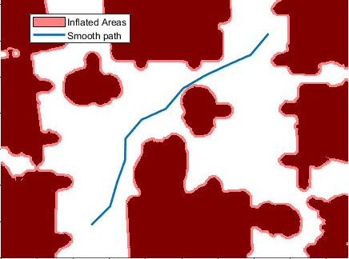
Path Planning
Path Optimization
Later the path is optimized to have minimum nodes with straight paths
Planned path in Costmap
Optimized Path

Slide 29
EXTERNAL VISION BASED NAVIGATION AND PATH PLANNING
Notes:
Thanks Ms Mursina, And good morning everyone. I am Umair Ahmadh, dealing with the part of this project, the navigation system which is the main driving force of our goal. Let me get straight into the show.

Slide 30
Robot Control and Navigation
Navigation System
Sending Step Counts for each motors to move
Sending current position when obstacle is encountered for path regeneration

Slide 31
Robot Movement
Camera captures and generate path

Slide 32
Robot Movement
Robot needs first to rotate towards the next node

Slide 33
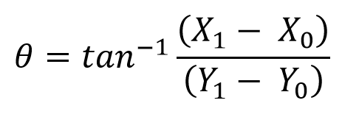
Robot Movement

Slide 34
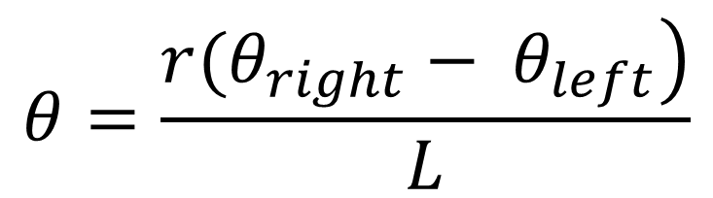
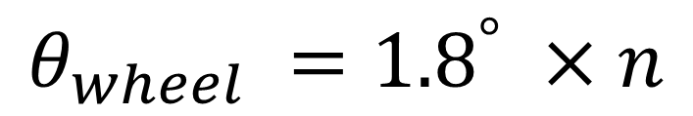
Robot Rotation
$$θ=\frac{\left.r(θ_{right}− θ_{left}\right)}{L}$$
$$θ_{wheel} ={1.8}^{°} ×n$$

Slide 35
Robot Rotation
$$θ=\frac{\left.r(θ_{right}− θ_{left}\right)}{L}$$
$$θ_{wheel} ={1.8}^{°} ×n$$

Slide 36
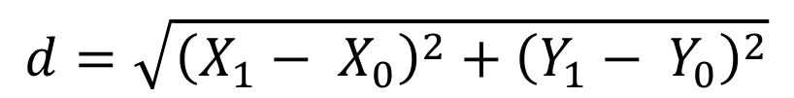
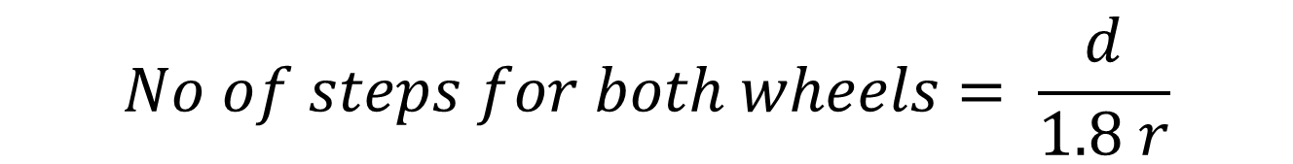
Robot Movement
$$d=\sqrt{{\left(X_{1}− X_{0}\right)}^{2}+{\left(Y_{1}− Y_{0}\right)}^{2}}$$
$$No of steps for both wheels= \frac{d}{1.8 r}$$

Slide 37
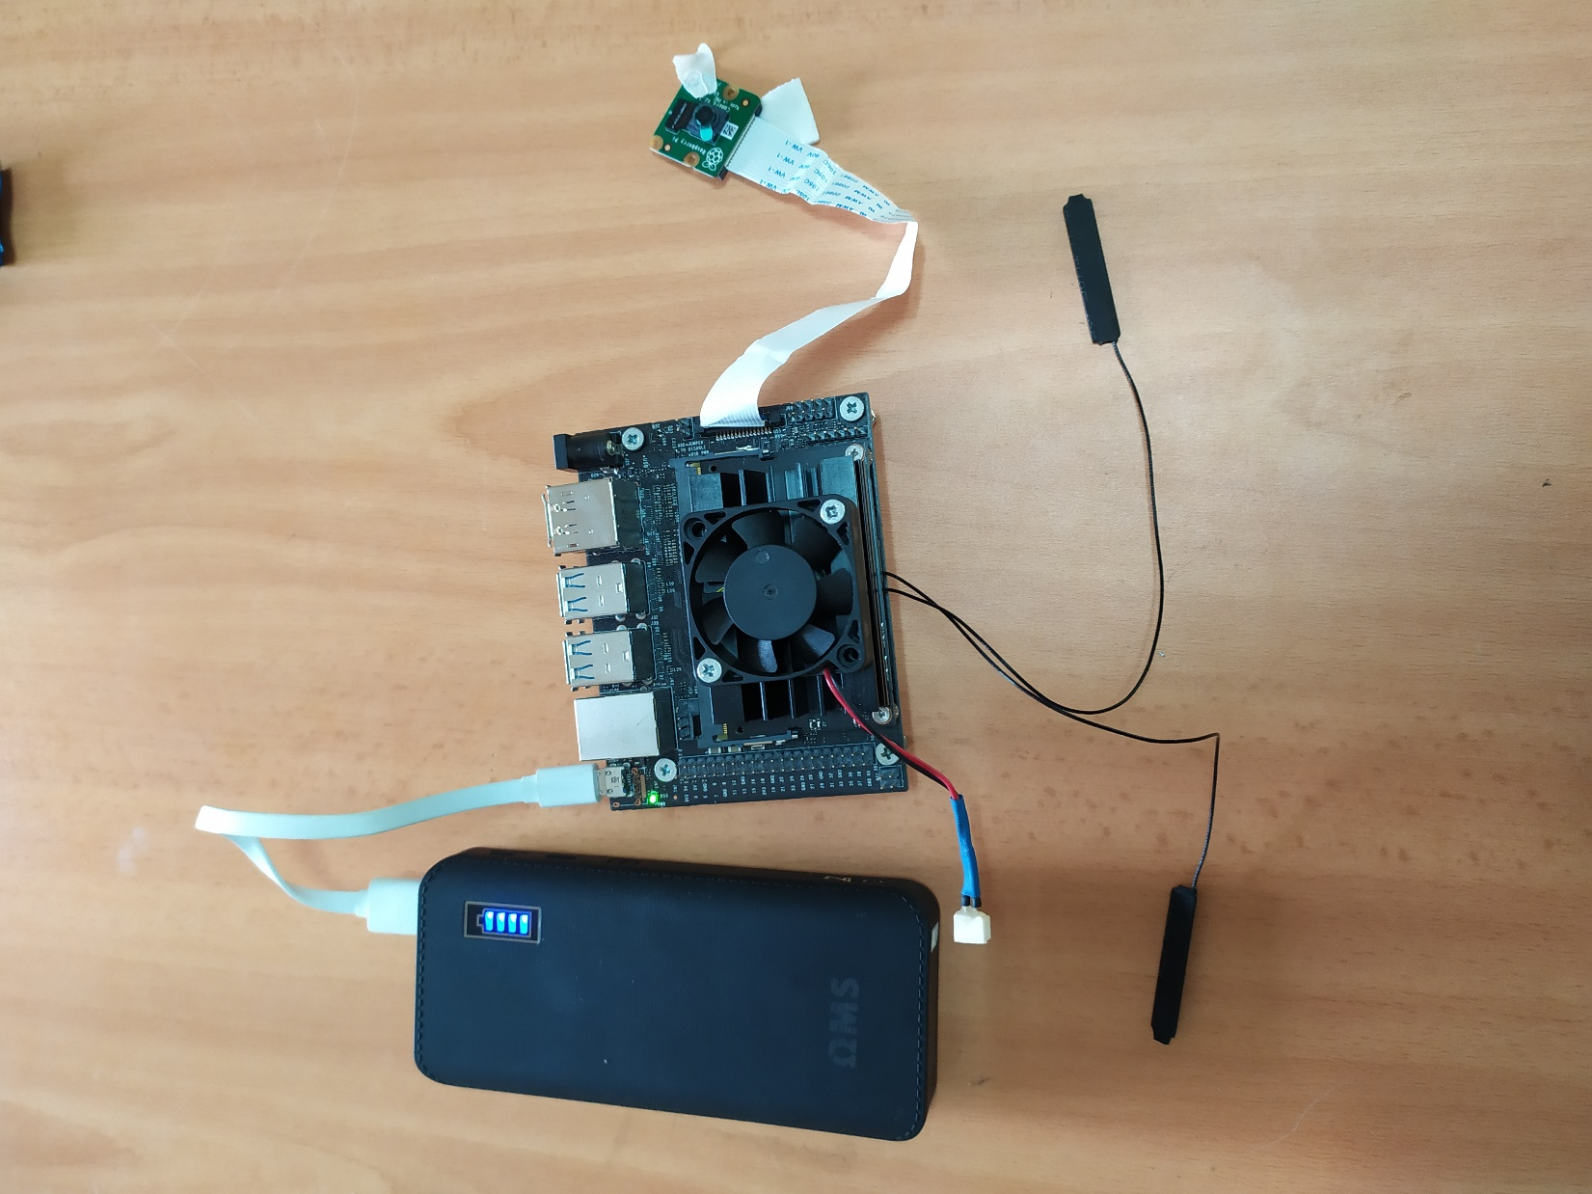
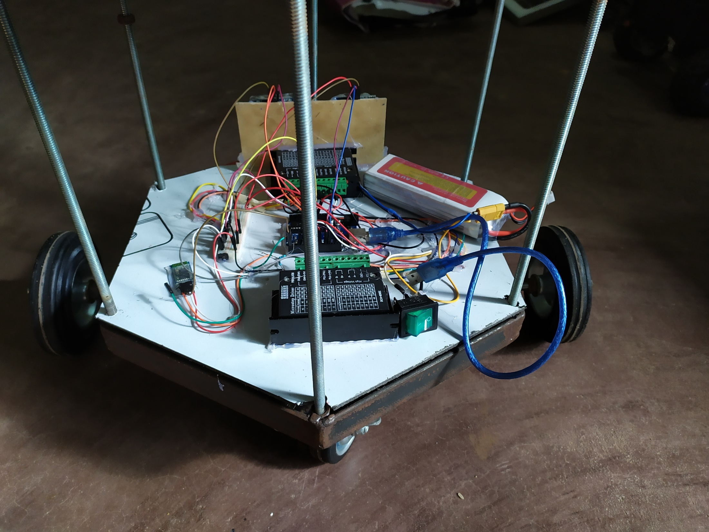
Piloting the Robot

Slide 38
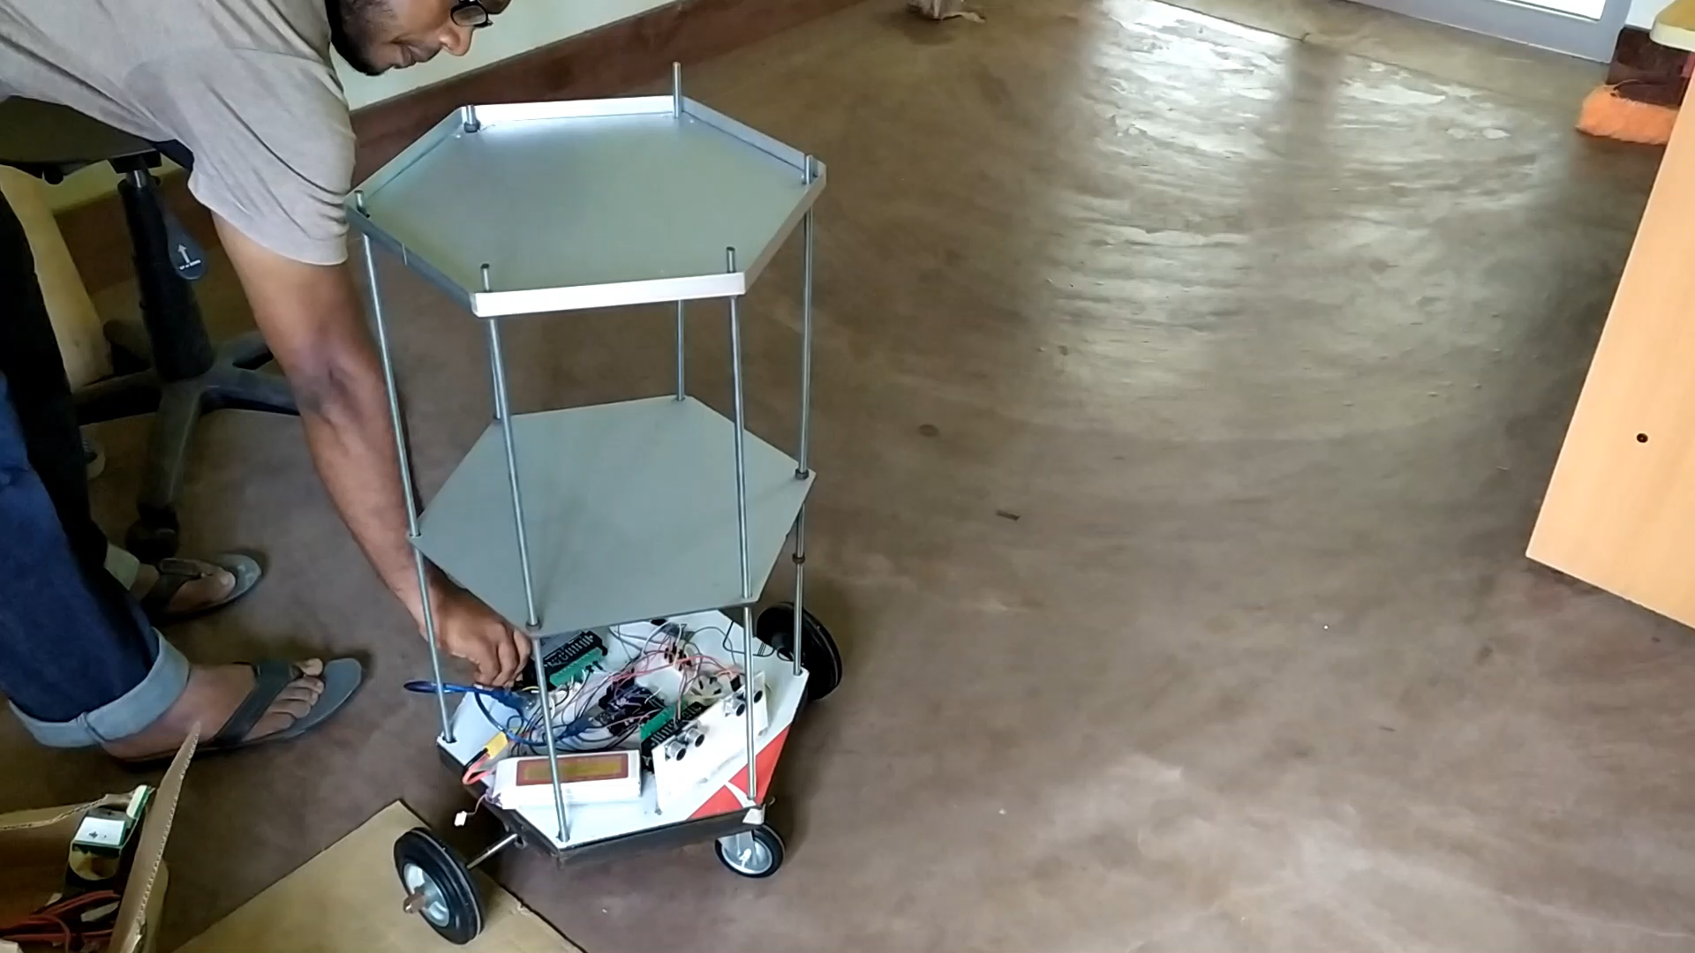
Piloting the Robot

Slide 39
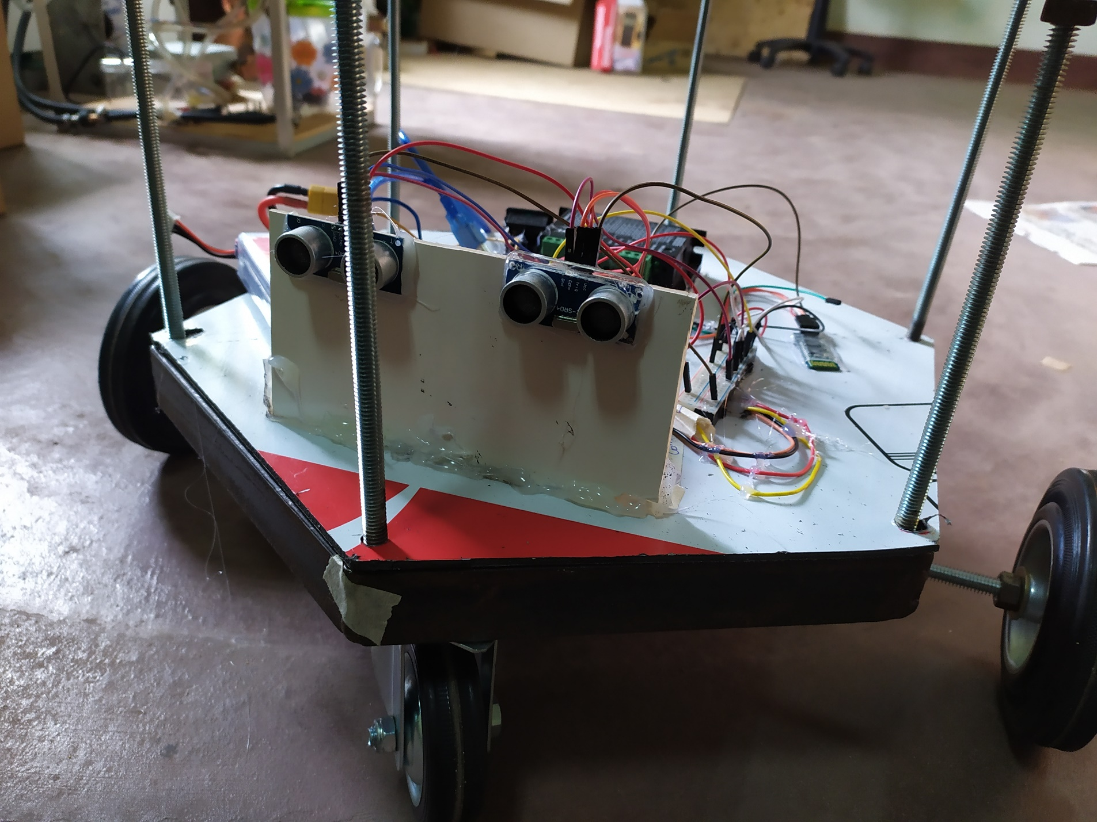
Obstacle Detection
Ultrasonic Sensors detects if any obstacles suddenly come across its path

Slide 40
Obstacle Detection
If Any obstacles are encountered robot waits for a period and sends to the processing system how many steps it has yet to move from the command it received.
Having it as the current position, navigation system regenerates a new path and pilot the robot according to it.

Slide 41
2019
Jun
Jul
Aug
Sep
Oct
Nov
Dec
2019
Today
62 days
6/19/2019
Order Management System
8/19/2019
73 days
8/19/2019
Vision based Obstacle detection and Path Planning
10/30/2019
62 days
10/30/2019
Navigation of the Robot
12/30/2019
84 days
6/24/2019
Building the Robot
9/15/2019

Slide 42
Thank You

Slide 43
Appendix

Slide 44
Calculation of motor torque
In our design we have 4 wheels and 2 motors.
Here we assume that the coefficient of friction is 0.6 and radius of wheel is 5 cm.
The weight acting on the four wheels can be written as,
N1 is the weight acting on each caster wheel.
N2 on each motor wheel.
$$\text{2 ∗ }\text{N}\text{1 + 2 ∗ }\text{N}\text{2 = }\text{Total} \text{Weight}$$
The maximum torque is required when the robot starts moving. It should also overcome friction.
To calculate the maximum torque (T),
$$\text{μ}\text{ ∗ }\text{N}\text{ ∗ }\text{r}\text{ − }\text{T}\text{ = 0}$$
μ is the coefficient of friction.
N is the average weight acting on each wheel.
r is the radius of wheels.
T is the torque.

Slide 45
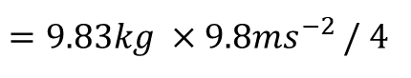
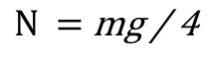
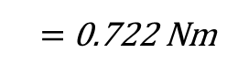
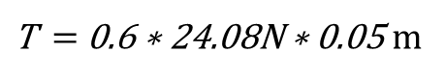
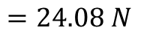
Calculation of motor torque
Assuming that the weight of the robot is equally distributed on all the four wheels,
$$\text{N} \text{=} \text{mg}\text{ / 4}$$
$=9.83kg ×9.8{ms}^{−2}$ / 4
$$=24.08 N$$
Motor torque required,
$\text{T} \text{=} \text{0.6 ∗} \text{24.08}\text{N}\text{ ∗ 0.05}$ m
$\text{=} \text{0.}\text{722 }\text{N}$m
Reference - Learning Robotics using Python by Lentin Joseph

Slide 46
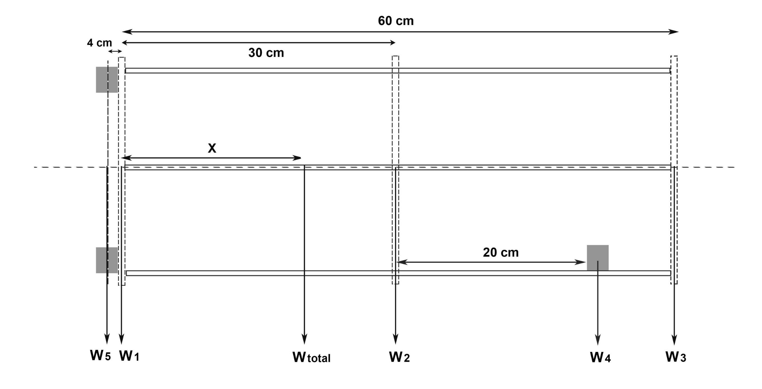
Center of Gravity Calculation
P
Based on weight estimation, we did a canter of gravity calculation for the design.
According to the calculation the Center of Gravity of the robot design is 0.235 m above the bottom plate.
It is 9.1cm below the center.

Slide 47
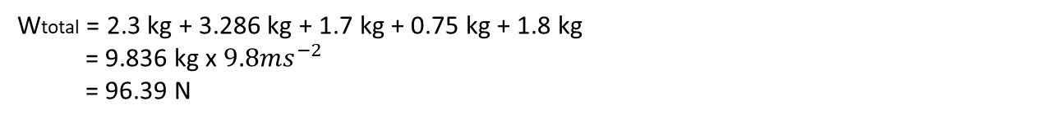
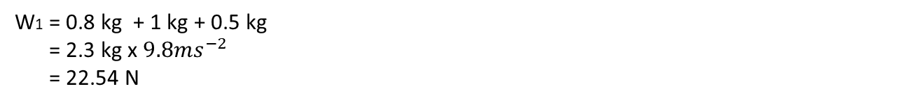
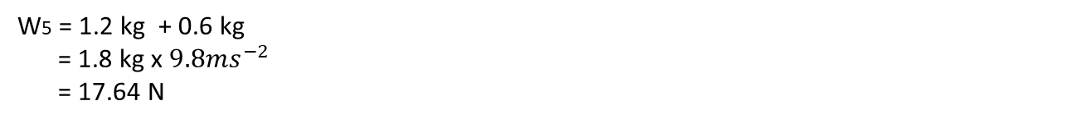
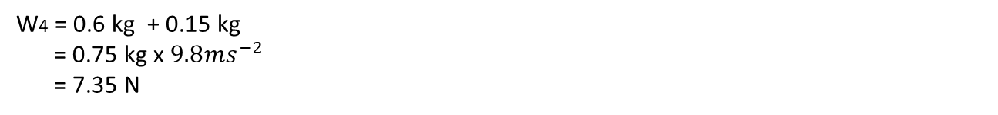
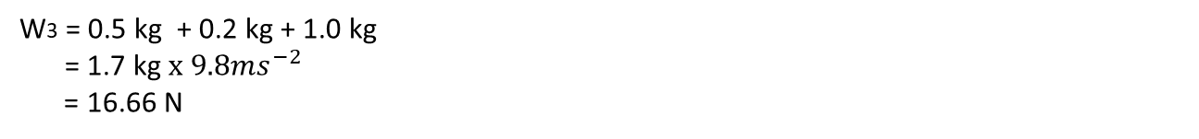
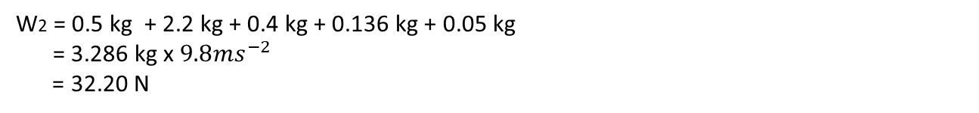
Center of Gravity Calculation
W1 = 0.8 kg + 1 kg + 0.5 kg
= 2.3 kg x $9.8{ms}^{−2}$
= 22.54 N
W2 = 0.5 kg + 2.2 kg + 0.4 kg + 0.136 kg + 0.05 kg
= 3.286 kg x $9.8{ms}^{−2}$
= 32.20 N
W3 = 0.5 kg + 0.2 kg + 1.0 kg
= 1.7 kg $x 9.8{ms}^{−2}$
= 16.66 N
W4 = 0.6 kg + 0.15 kg
= 0.75 kg x $9.8{ms}^{−2}$
= 7.35 N
W5 = 1.2 kg + 0.6 kg
= 1.8 kg x $9.8{ms}^{−2}$
= 17.64 N
Wtotal = 2.3 kg + 3.286 kg + 1.7 kg + 0.75 kg + 1.8 kg
= 9.836 kg x $9.8{ms}^{−2}$
= 96.39 N

Slide 48

Center of Gravity Calculation
P
Considering the moments around point P in clockwise direction,
W1 x 0 + W2 x 0.3 m + W3 x 0.6 m + W4 x 0.5 m - W5 x 0.04m = Wtotal x X
22.54 N x 0 + 32.20 N x 0.3 m + 16.66 N x 0.6 m + 7.35 N x 0.5 m - 17.64 N x 0.04m = 96.39 N x X
9.66 Nm + 9.996 Nm + 3.675 Nm – 0.7 Nm = 96.39 N x X

Slide 49
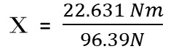
Center of Gravity Calculation
$\text{X}$ = $\frac{22.631 Nm}{96.39N}$
X = 0.235 m
According to the calculation the Center of Gravity of the robot design is 0.235 m above the bottom plate. It is 9.1cm below the center.

Slide 50
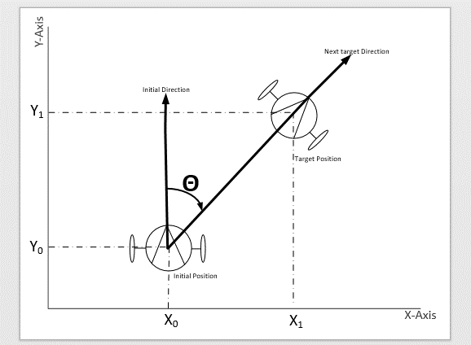

Calculation of turning angle of the robot
Using the following equation, the angle of rotation of the robot is calculated. Based on which we will rotate the motors to turn the robot to be straight to the next coordinate.
function calculate_Angle(x0,y0,x1,y1){
Robot_rotation_angle $=\tan^{−1}\frac{\left(X_{1}− X_{0}\right)}{\left(Y_{1}− Y_{0}\right)}$
return robot_rotation_angle;
}

Slide 51




Wheel rotation angle calculation
$$ω=\frac{\left.r(ω_{right}− ω_{left}\right)}{L}$$
$$θ=\frac{\left.r(θ_{right}− θ_{left}\right)}{L}$$
$$θ_{wheel} ={1.8}^{°} ×n$$
function motor_steps_for_robot_rotation(robot_rotation_angle){
Left_motor_steps = L * robot_rotation_angle / (3.6*r)
Right_motor_steps = - left_motor_steps
return right_motor_steps, left_motor_steps;
}

Slide 52


Calculation of straight-line travel distance for the robot
Using the following function, the distance the robot needs to travel in straight in order to reach the next coordinate can be calculated. Based on which we will rotate the motors to drive the robot in straight until reaching the target coordinate.
function calculate_distance(x0, y0, x1, y1){
Calculate robot_straight_travel_distance = $\sqrt{{\left(X_{1}− X_{0}\right)}^{2}+{\left(Y_{1}− Y_{0}\right)}^{2}}$;
return robot_straight_travel_distance;
}

Slide 53
Calculation of wheel rotations to travel straight to the next coordinate
In one revolution of the wheel, it travels the distance equal to its circumference. Based on this the motor steps can be calculated by using following function.
Function motor_steps_for_robot_travel(robot_straight_travel_distance){
d =robot_straight_travel_distance;
steps = d/(1.8*r);
return right_motor_steps, left_motor_steps;
}

